Slide 1

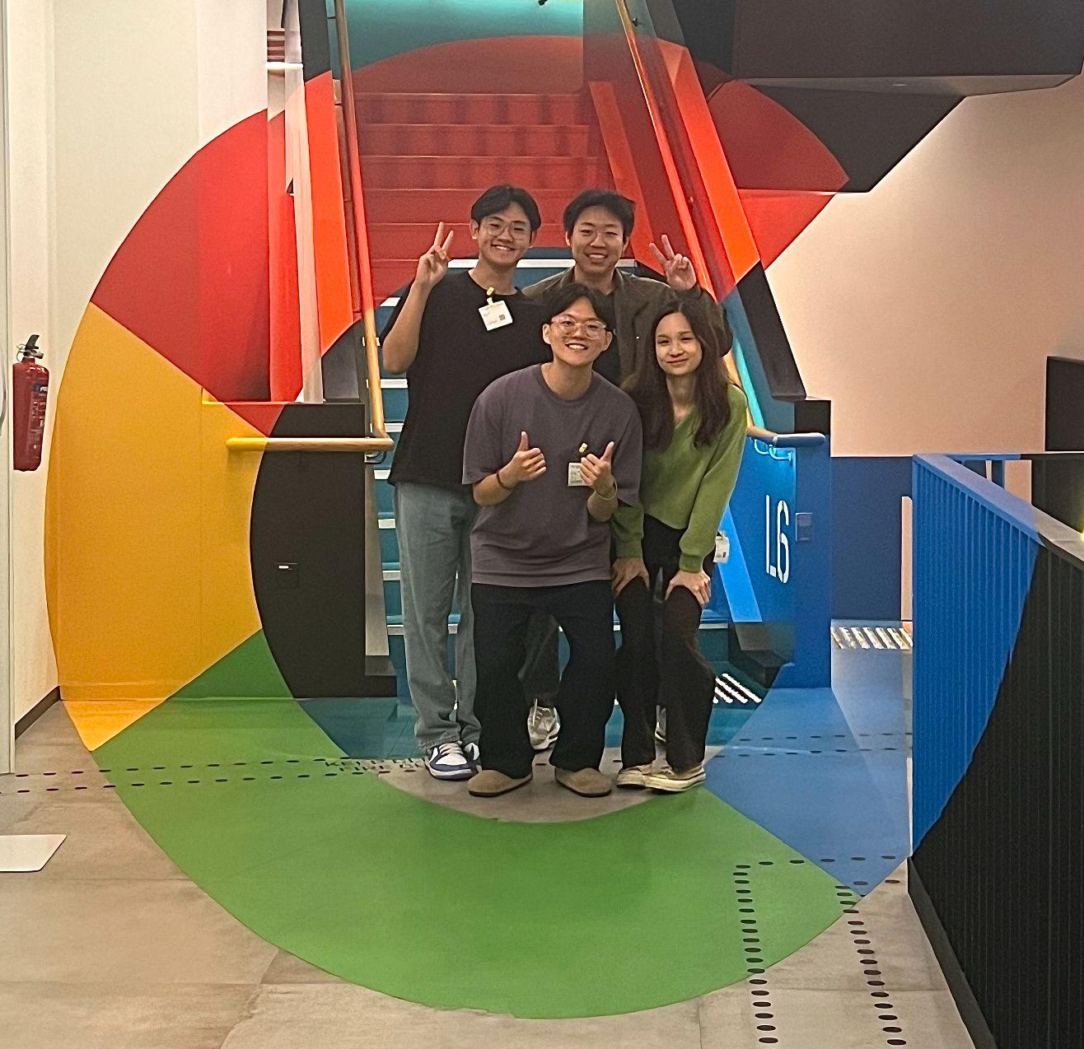
A sustainability project by Gooders
By
Wong Choon Pin
Hein Zaw Htet
Waiwarit Sae-yang
Kuan Zhuo En Rae
Notes:
Good morning everyone, we are gooders. I know our name may sound familiar and whatnot but our name just comes from us trying to do good, do good for the environment, do good right now, and do good for society.

Slide 2
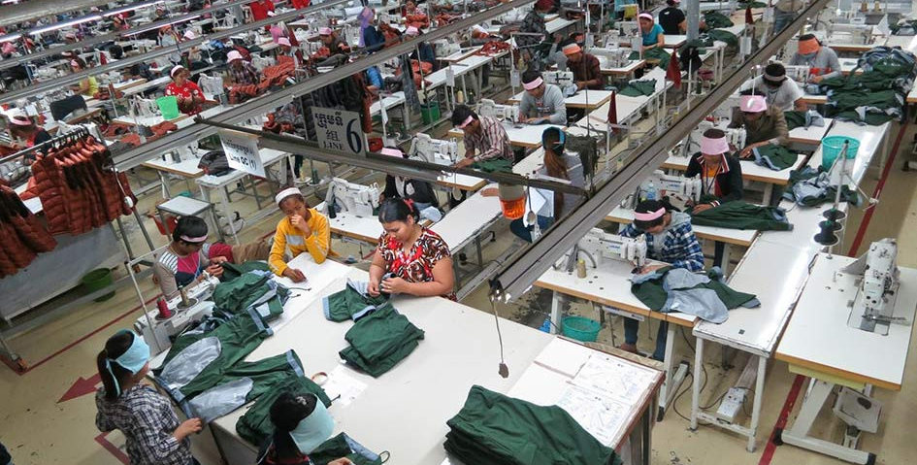
What is fast fashion
Frequent inventory turnover
Low prices
Rapid production cycles
Disposable fashion culture
Notes:
So let’s bring us to todays topic, where we will be addressing the fast fashion industry. It’s not exactly a novel conversation but certainly doesn’t make it less worthy of bringing up because of the massive, massive impact it has on our mother earth. First, a brief introduction to fast fashion.
Fast fashion, coined in the 1990s by the New York times to describe Zara’s mission to take only 15 days for a garment to go from the design stage to being sold in stores. The biggest players in the fast fashion industry include Zara, Uniqlo,Forever 21 and H&M.

Slide 3
Impact of Fast Fashion
Fast fashion industry
10%
1.2 billion tonnes
Global carbon emissions
Notes:
The impact?
Fashion production comprises 10% of total global carbon emissions. To put that into perspective, that is as much as the entire European Union population. At its massive production scale, it emits a whopping 1.2 billion tonnes of CO2, and dries up water sources and pollutes rivers and streams.

Slide 4
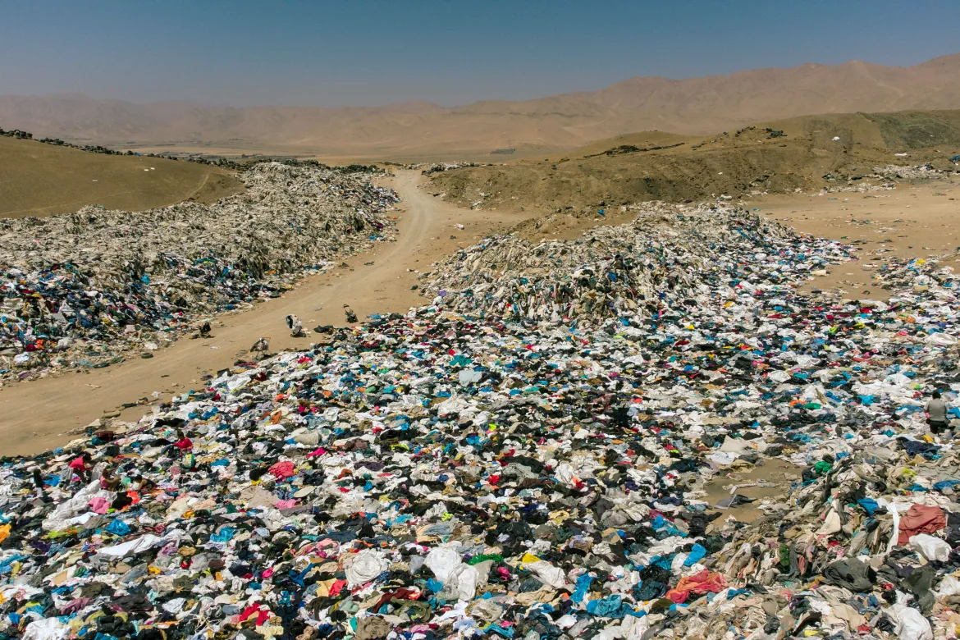
Impact of Fast Fashion
92 million tonnes disposed
Notes:
Its impact doesn’t just stop there. Us consumers can’t even keep up with the massive volumes they are producing. So what’s the result? An estimated 92 million tonnes of clothes are disposed of each year. Textile and packaging waste, which doesn’t easily decompose, puts stress on landfills, emits even more greenhouse gasses, and leaches toxic chemicals and dyes into our soil and water.

Slide 5
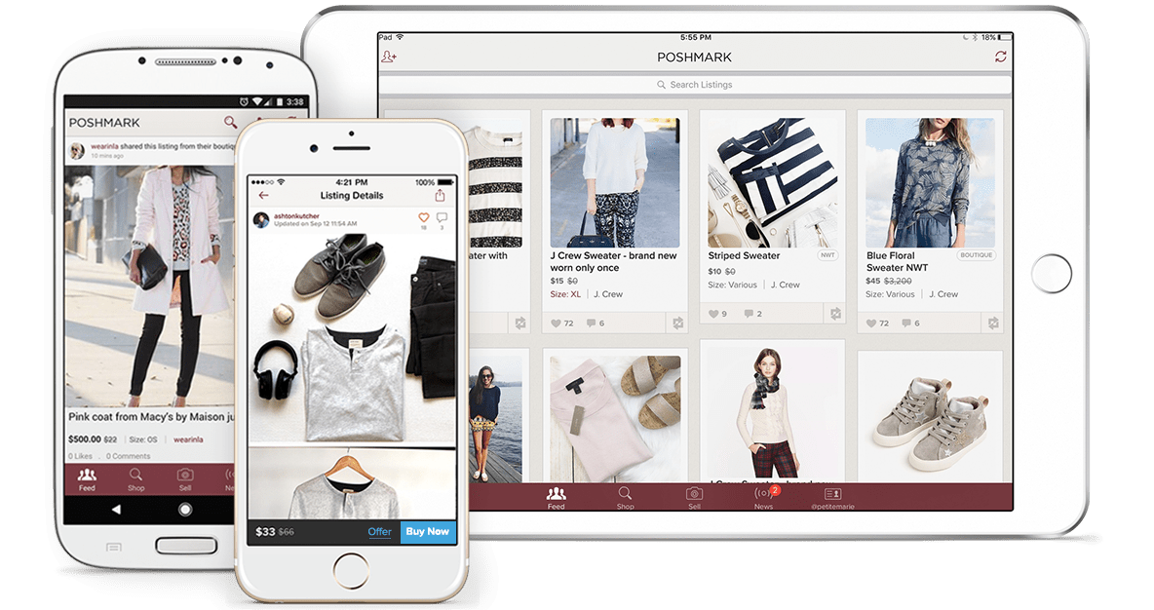

Is Thrifting the answer?
Notes:
So what can we do to stop or mitigate the effects of excessive production in fast fashion?
Slow fashion is the widespread reaction to fast fashion and its environmental impact; the argument for hitting the brakes on excessive production, overcomplicated supply chains and mindless consumption. One form of practicing slow fashion is thrifting, such as buying from secondhand sellers like Carousell or vintage clothing stores in Singapore or Thredup and Poshmark in the USA. Shoppers send their unwanted clothes to these websites and people buy those clothes at a lower price than the original.

Slide 6
Is Thrifting the answer?
Production
Disposal
Notes:
Not only do we reduce the need to produce clothing, it also curbs the environmental degradation that results from textile disposal.

Slide 7
Thrifting trends
Expected to reach a staggering
US$350 billion (S$479 billion)
by 2027
Notes:
According to the ThredUp 2023 Resale Report, the global used clothing market, which includes online thrift stores, is expected to reach a staggering US$350 billion (S$479 billion) by 2027. This showcases the immense growth potential and demand for thrifted fashion worldwide.

Slide 8
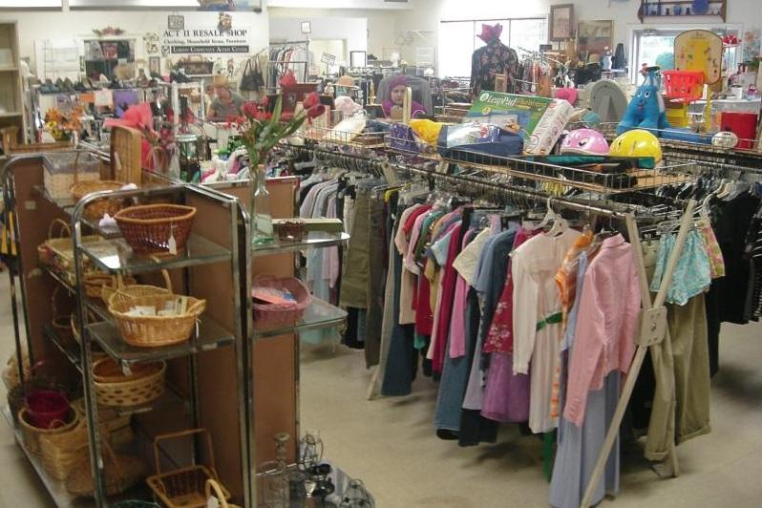
What’s stopping people from thrifting?
Unorganized stores
Unpleasant smells
Damaged clothes
Notes:
Thrifting seems like the obvious answer to curb this massive problem then? Not quite.
In a study to explore Millennial Perceptions of Clothing Preferences Using Q Methodology, Consumers’ perceptions of second-hand clothing are not as positive for a variety of reasons. Many perceived second-hand stores to be disgusting due to the belief that these stores have unpleasant smells, damaged clothing, and an unorganized store appearance.
And that’s why the online thrift sector in Singapore is a great alternative and has been experiencing growth. Despite that, its main challenge is gaining the trust of consumers. Unlike traditional retail stores, where shoppers can physically inspect items before making a purchase, online thrift stores rely on detailed descriptions and photographs. Consumers also express concern over the perceived poor product quality of second-hand clothing. This can create a hesitancy among buyers who may be concerned about the condition and quality of the pre-loved items. The online thrifting sector has massive potential to promote thrifting as a sustainable alternative to fast fashion, but not unless we overcome this challenge.

Slide 9
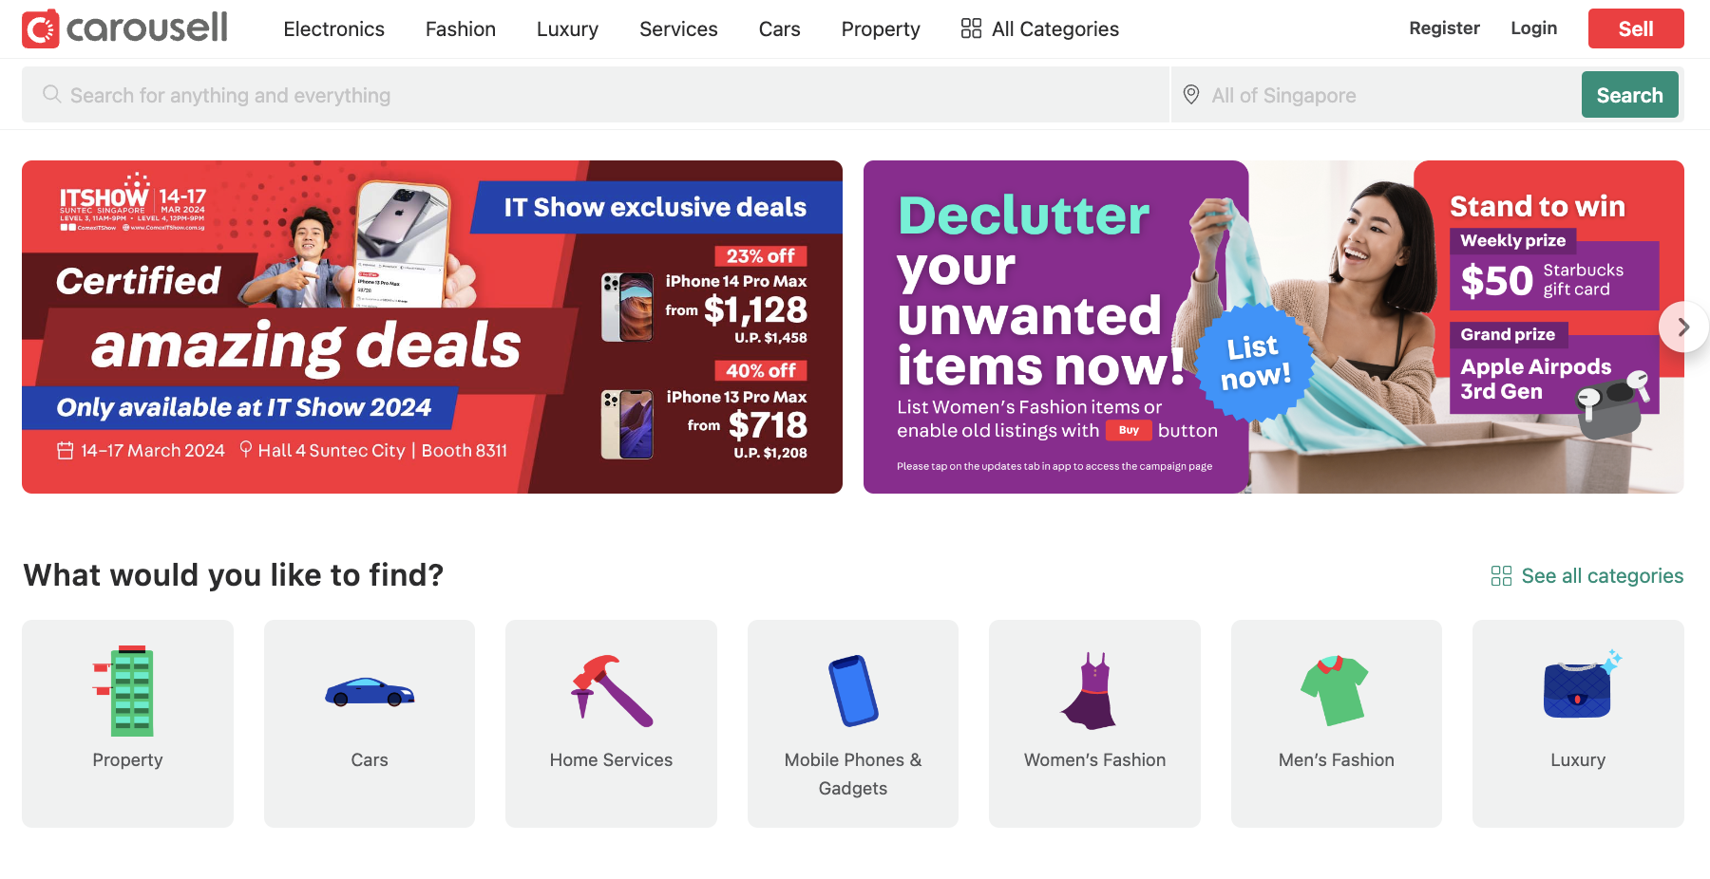
Carousell
Notes:
Let’s take a look at some second-hand e-commerce sites currently, with Carousell being one of the most popular here in Singapore. From a consumers’ perspective, the biggest challenge we have identified is the over-reliance on sellers’ claims on the condition of the item.

Slide 10
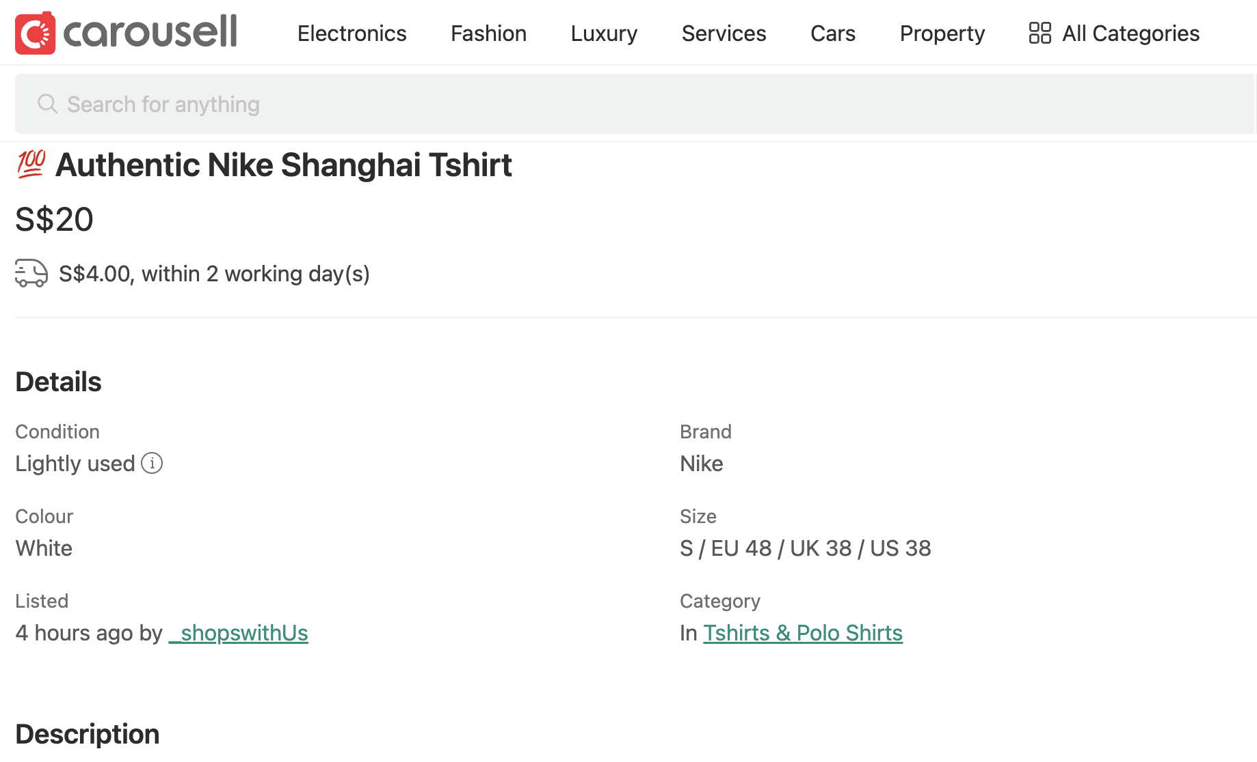
Carousell
Notes:
Carousell does have a feature to indicate condition, where sellers categorize them as “Heavily used, well-used, lightly used, like new, or brand new”. It’s a rather ambiguous and subjective metric, and certainly does not help combat consumers’ negative impressions of second-hand clothing.

Slide 11
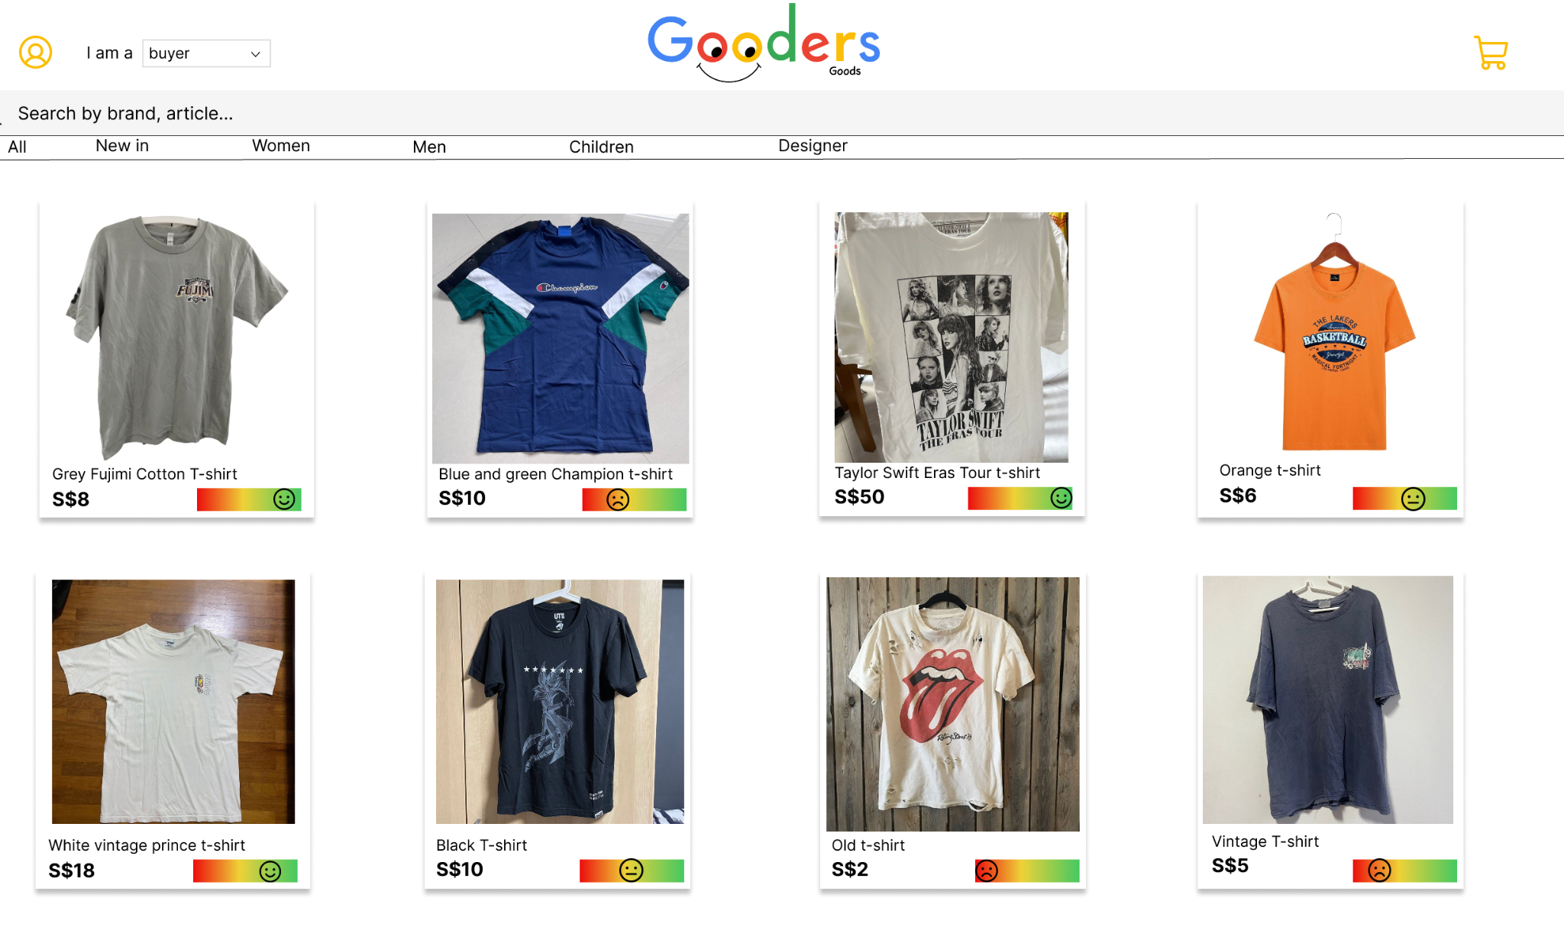
Gooders Goods
Notes:
Our solution? Gooders Goods, our very own online thrift store using AI to analyze the quality of second-hand clothing based on their current condition.

Slide 12

What is our solution?
Goodness rating
Notes:
They are assessed based on the presence of holes, stains and fabric degradation, including signs of fraying and pilling. Based on these factors, they are assigned a Goodness rating.

Slide 13
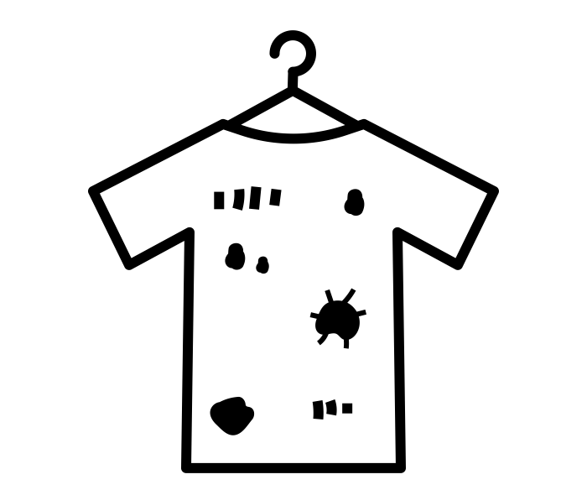
Data engineering
Stains
Holes
Fabric degradation
Notes:
We did this by first preparing a dataset of clothing where each item is labelled according to its condition in 3 main factors of stains, holes and fabric degradation which consists of fraying and pilling. To improve the model's robustness and ability to generalize from our dataset, we applied data augmentation techniques. These included rotations, scaling, flips, and variations in lighting conditions. Each factor was labelled as low, medium or high based on its condition which we determined based on wearability and lifespan. We also had a separate label for items in good condition which we labelled as Good.

Slide 14
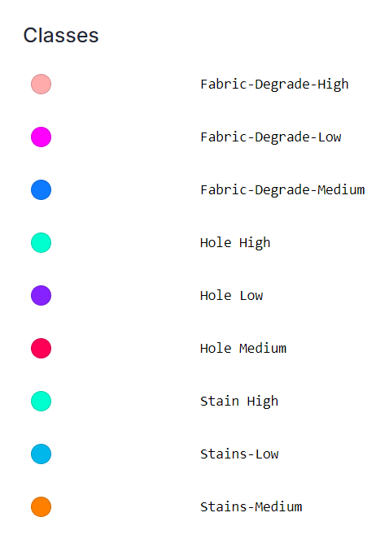
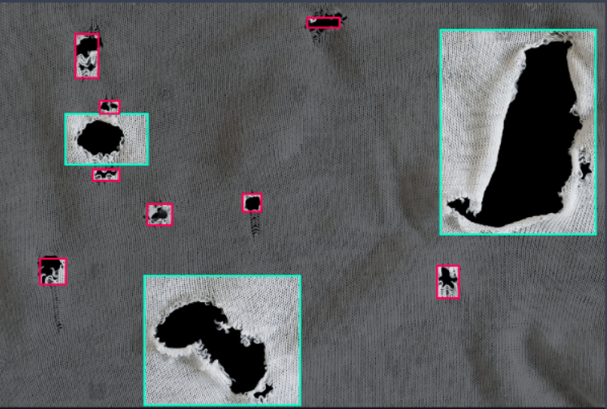
Data engineering
HIGH
MEDIUM
LOW
Notes:
We did this by first preparing a dataset of clothing where each item is labelled according to its condition in 3 main factors of stains, holes and fabric degradation which consists of fraying and pilling. To improve the model's robustness and ability to generalize from our dataset, we applied data augmentation techniques. These included rotations, scaling, flips, and variations in lighting conditions. Each factor was labelled as low, medium or high based on its condition which we determined based on wearability and lifespan. We also had a separate label for items in good condition which we labelled as Good.

Slide 15
Training Model
Data Collection
740 Total Images
592 Training sets
74 Test sets
74 Valid sets
+
+
Notes:
We obtained a dataset of over 700 images, after which we trained the model using Vertex AI.

Slide 16
Training Model
Goodness = Sum(Confidence Ratings x Weights)
Weights
High 1
Medium 2
Low 3
Perfect 4
Notes:
In our data processing, we assigned weights to each factor, giving most importance to fabric degradation, followed by holes and stains. Using the data we obtained from our model, we then calculated the goodness rating which we will assign to the clothes, with 1 as the worst condition and 5 as in the best condition.

Slide 17

Demonstration

Slide 18

Website demonstration

Slide 19
Gooders Goods
Goodness rating :)
Notes:
Finally, we obtain a goodness rating!

Slide 20

Impacts
?
Objective and consistent metric
Reduce uncertainty
More encouraged to thrift
Notes:
The ultimate goal is to give our customers more objective and consistent insight on the quality of the clothing, helping them make a more informed decision. This aims to reduce consumers’ uncertainty on the quality and condition of clothes they get when they thrift online, which would in turn encourage more people to explore thrifting as a means of getting a new wardrobe.

Slide 21


Impacts
Buyer
Seller
I can help reduce the production of new clothes!
I can help reduce the disposal of preloved clothes!
Notes:
By taking the guesswork and subjectivity out of online thrifting, we make thrifting a less daunting idea to consumers, so that they explore pre-loved clothes as an alternative to purchasing brand new clothes.
Similarly, for sellers, by giving them a platform to let go of their preloved clothes to others instead of disposing it, it reduces environmental issues linked to disposal and textile waste.

Slide 22
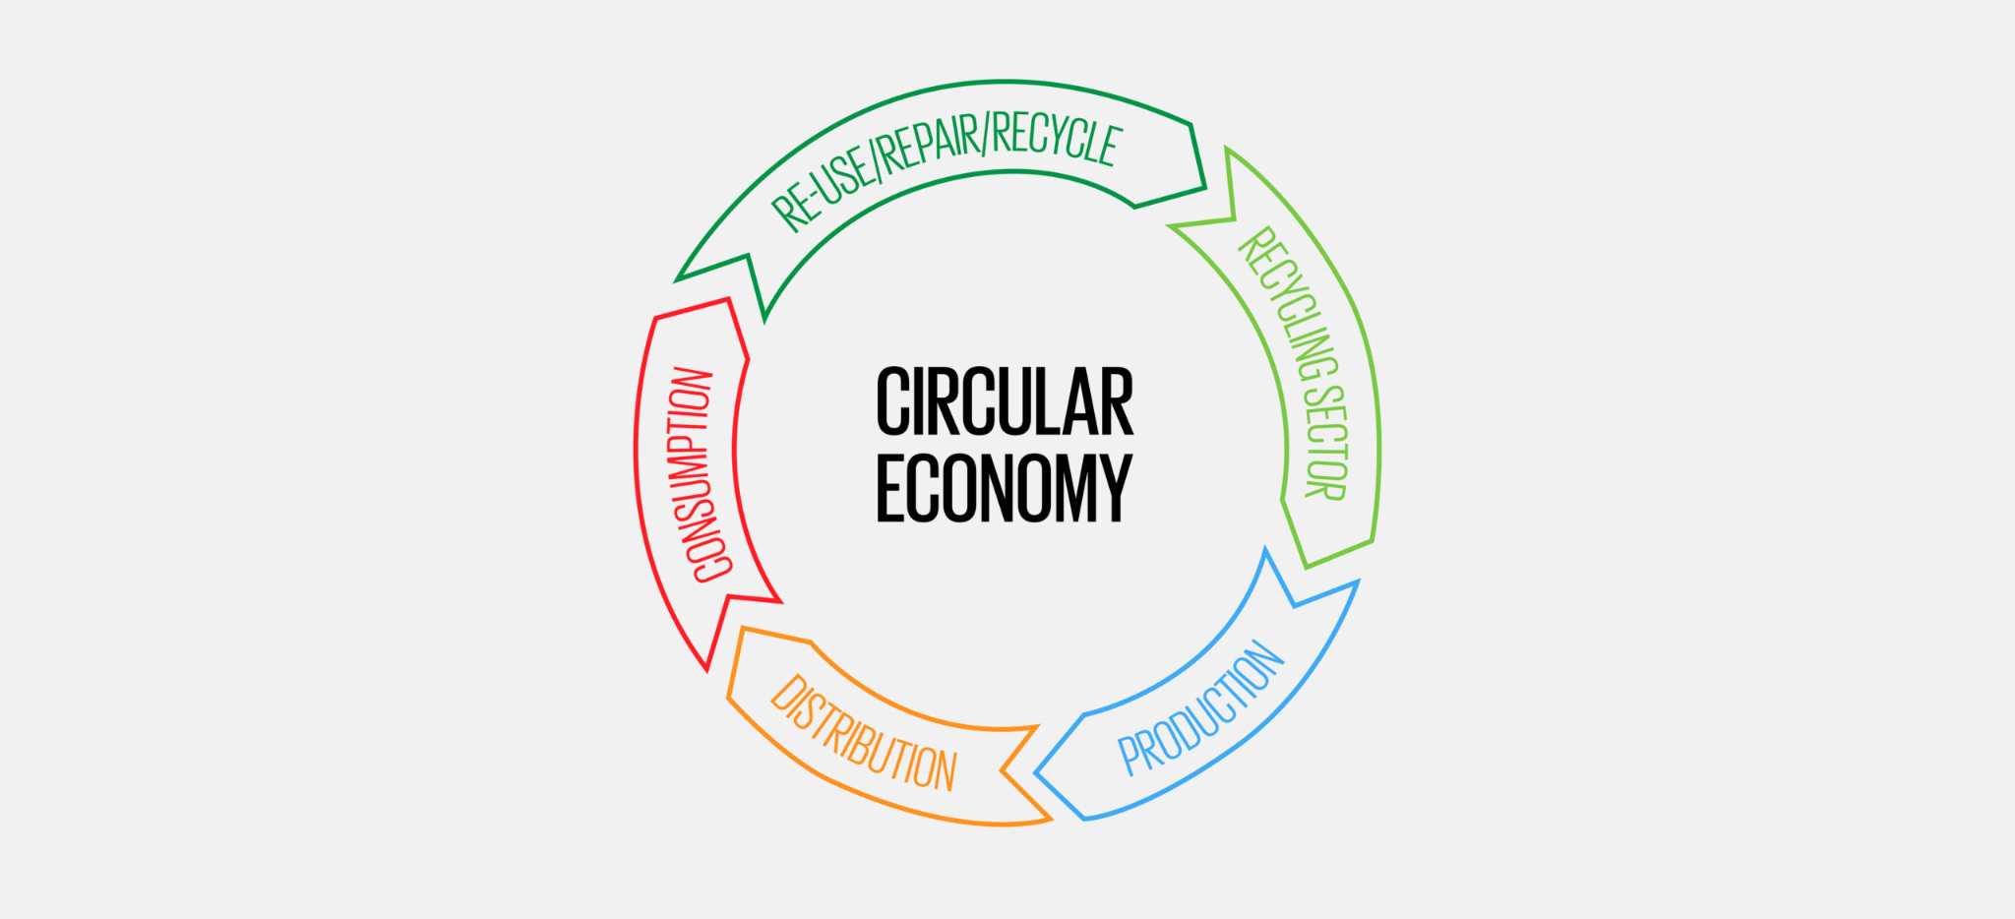
Impacts
Notes:
By making second hand clothing more accessible to the masses, we hope to change consumer behaviour around the world where they look towards thrifted clothing instead of fast fashion and thus promote a circular economy

Slide 23
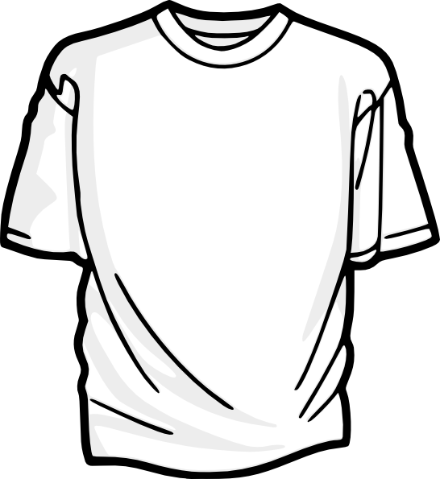
Success Metrics
No. of pieces sold through our website
Average carbon emission/T-shirt
Buying & re-wearing pre-loved clothes
reduces carbon footprint of 25% per garment
7 kg of CO₂ emissions
Notes:
How will we quantify our success? It is difficult to quantify the actual carbon footprint of each piece of clothing in production. However, estimates can be made based on where the clothing is manufactured and the material used. The average carbon footprint of a T-shirt is about 7kg of carbon emissions in its manufacturing process. ThredUp’s latest figures suggest that buying and rewearing pre-loved clothing can reduce the carbon footprint of a garment by an average of 25 per cent, due to the fact that the vast majority of emissions come from production of the garment itself. We can calculate estimates of the carbon offset from emissions based on the number of sales generated through our website, since each article of clothing bought and sold is an article of clothing not bought from fast fashion retailers. Therefore, our key metric for success is the number of pieces sold.

Slide 24
Learning and Key Takeaway
-Since Semifinals
1. Getting industry expert QA checkers to label the initial dataset (eg. stains vs patterns)
2. Use LLM to generate more images to feed into dataset
3. Active learning (Feedback system)
4. Framing system

Slide 25
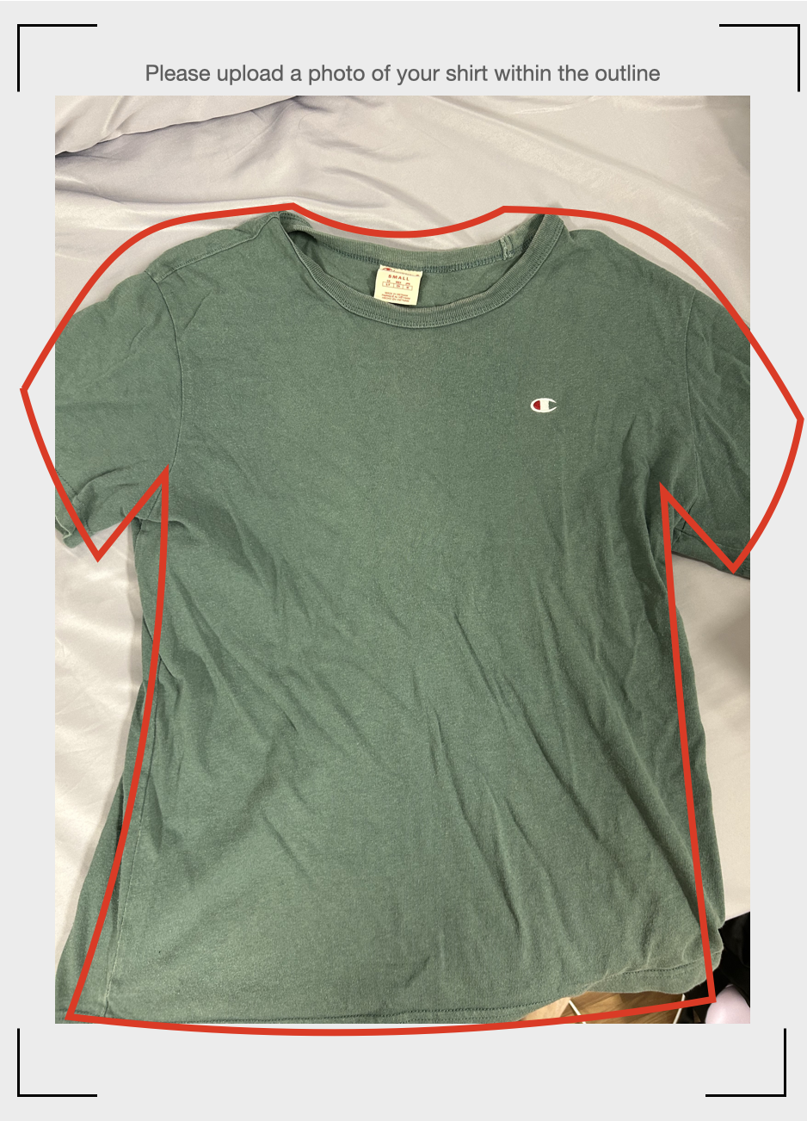
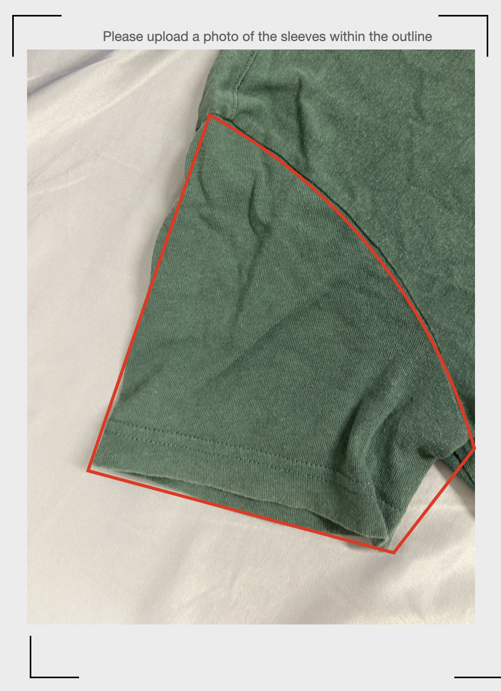
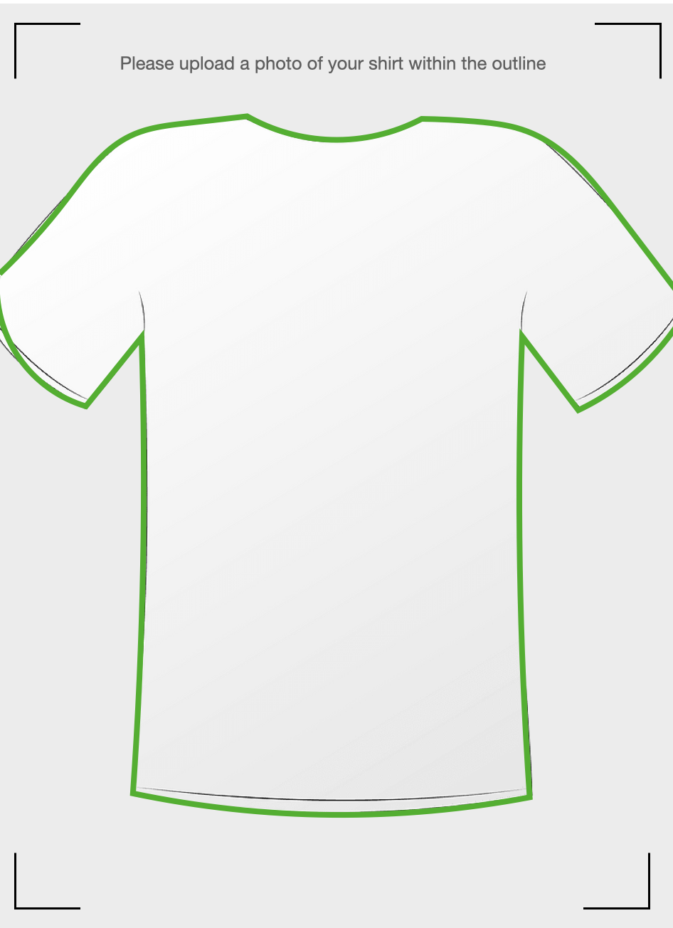
Framing

Slide 26
THANK YOU
Get Good Goods with

